Slide 1
Cytoscape Lab Session
Bioinformatics 525
Viji Nair and Marci Brandenburg
March 2016

Slide 2
Cytoscape
Cytoscape = an open source platform for visualizing and integrating complex biomolecular networks/databases with any high throughput data.
Software “core” provides basic network functionality
Cytoscape “Plugins”/”apps” are developed for several problem domains including Biology, Social Sciences and Semantic Web
Initially made public in 2002
Latest version = 3.3
http://www.cytoscape.org/
Apps: http://apps.cytoscape.org/
Notes:
There are other software tools that can be used for the visualization and integration of network data as well. But here we are focusing on cytoscape

Slide 3
Cytoscape – Molecular biology Domain
Cytoscape supports molecular and systems biology, genomics, and proteomics.
Molecular and genetic interaction data sets can be imported in many formats
Network (graph) with genes, proteins, and molecules represented as nodes, and interactions represented as links (edges) between nodes
Perform advanced analysis and modeling using Cytoscape apps for different “omics” datasets

Slide 4
Alternative Network Visualization Tools
Resource | Cost | Website
VisANT | Free/open source | http://visant.bu.edu/
Pathway Studio | Cost | http://www.elsevier.com/online-tools/pathway-studio/biological-database
Miru | Cost | http://kajeka.com/miru/miru-about/
Biological Networks | Free | http://biologicalnetworks.net/
GeneGO/ Metacore | Cost | http://thomsonreuters.com/metacore/
Osprey | Free or Cost | http://biodata.mshri.on.ca/osprey/servlet/Index
PathArt | Cost | http://www.jubilantbiosys.com/services/functional-discovery-services/discovery-informatics/commercial-products
Vanted | Free | http://www.webcitation.org/query.php?url=http://vanted.ipk-gatersleben.de&refdoi=10.1186/1471-2105-7-109
Information courtesy : Alex Ade & Alla Karnovsky
Notes:
Cytoscape is not the only network visualization tool available; here is a table listing some other options; some are free and some require a fee.

Slide 5
Download the three files from Ctools
Cytoscapeoverview.txt
Reactomedata.txt
Metscape_test.csv
aminoacids.output.pcor_lasso.17of23.csv

Slide 6
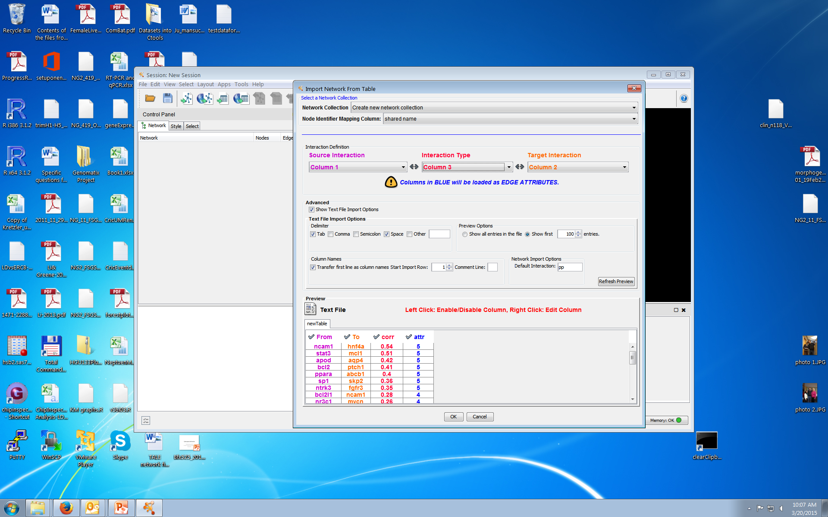
1.File -> Import -> Network -> File 2.Browse for the file you want to open 3.Click on “Show Text File Import Options”. Select the type of delimiter. Check “Transfer first line as column names” if you have a header row. Clear the “Default interaction” to empty 4.Select the appropriate column from the pull down menu for Source Interaction, Interaction Type, Target Interaction . See that the color type changes in your preview window 5.Left click on the column header to be imported as the edge attribute in the Preview window 6.Click OK

Slide 7
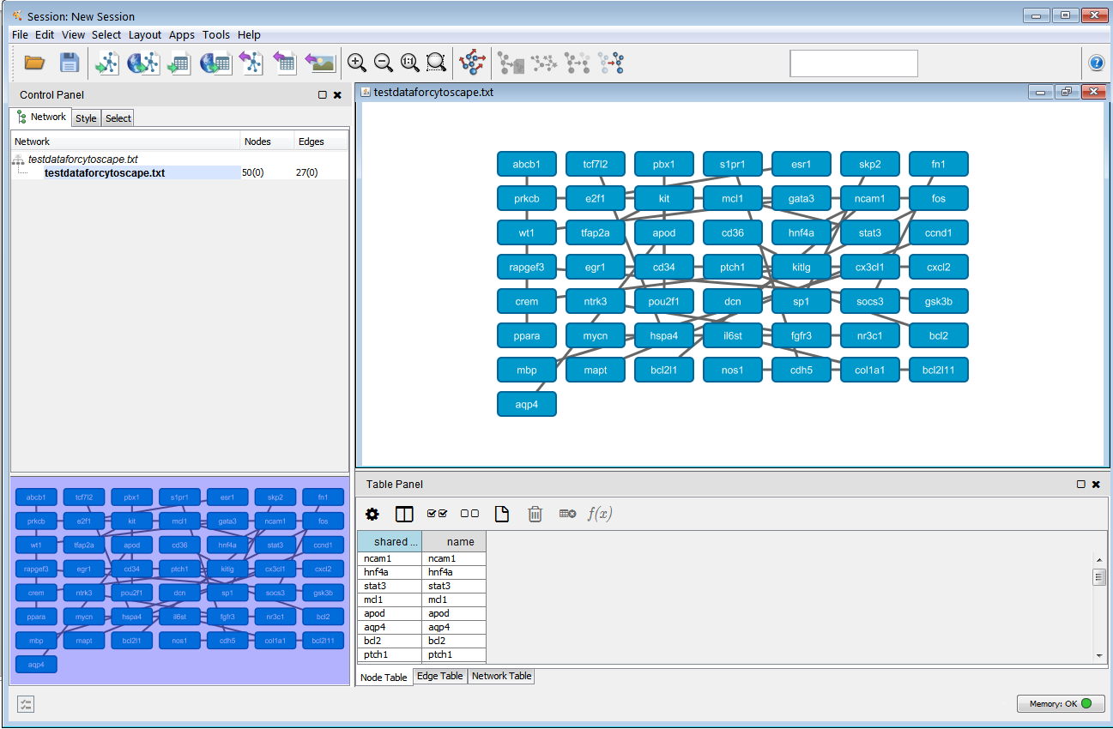
Uploaded view

Slide 8
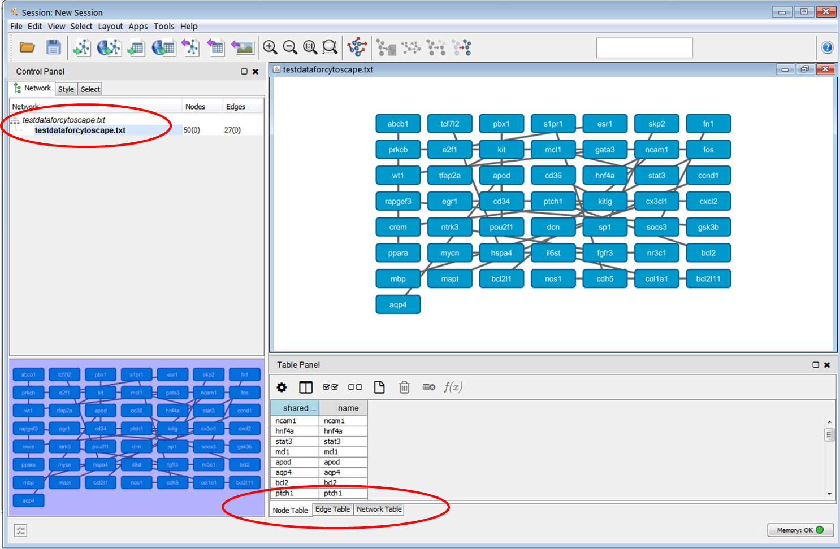
A Cytoscape Network preview
Menu Bar : The Menu Bar contains all of the functions that you may need to use for your network in Cytoscape
Tool Bar
Tool Bar : The Tool Bar contains shortcut keys for the most popular Menu Bar functions.
Control Panel : The Control Panel contains tabs that allow you to specify functions for your network. The Network tab gives you access to the Network Management Panel where you select specific networks with which to work if you have multiple networks uploaded in a single session.
Network View Window
Network View Window : The Network View Window displays the networks you have uploaded or created
Network Management Panel
Table Panel : The Table Panel allows you to control the information displayed in the Attribute Browser Panel.
Overview Panel : The Overview Panel allows you to navigate through portions of your network by dragging and moving the shaded square.
Overview Panel
Attribute Browser Panel : The Attribute Browser Panel allows you to look at attribute information for your nodes, edges and overall network..
Attribute Browser Panel

Slide 9
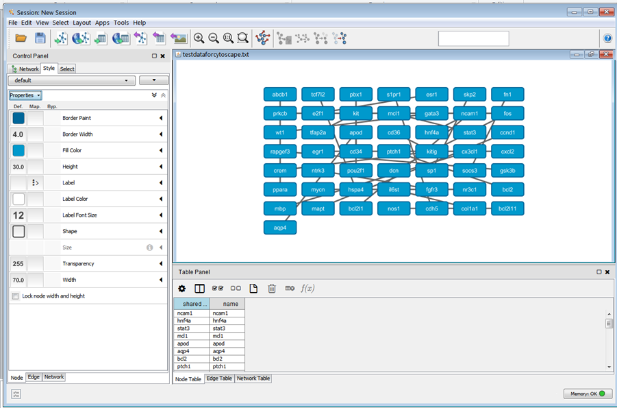
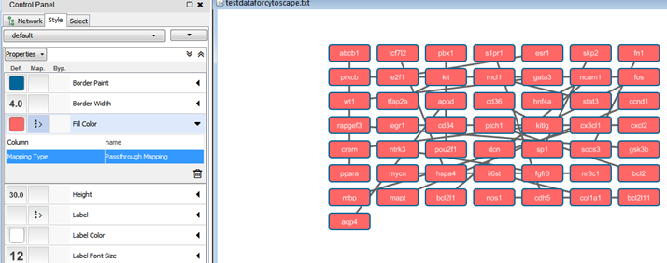
Global Visual Properties
Select “Style“ tab
Select the tab that you want to make changes on (Node, Edge, Network)
Click on the attribute you want to change,
eg : click on “Shape”
Changes will be applied to network once selected
Tabs

Slide 10
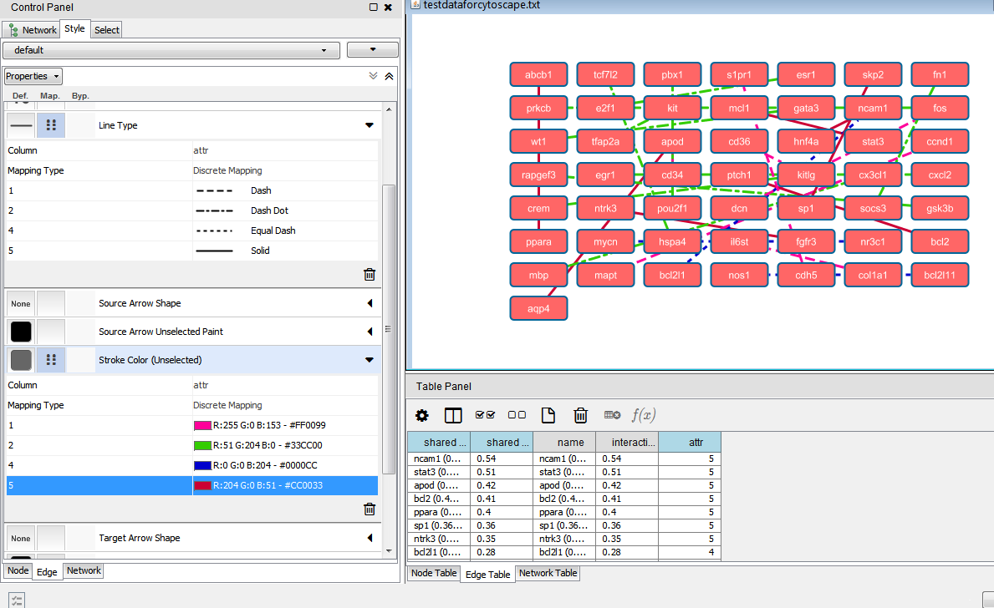
Specific Visual Properties
Select “Edge Table“ tab
Click on the pull down menu next to the attribute you want to change,
Stroke Color
Select “attr” for column
Select “discrete Mapping”

Slide 11
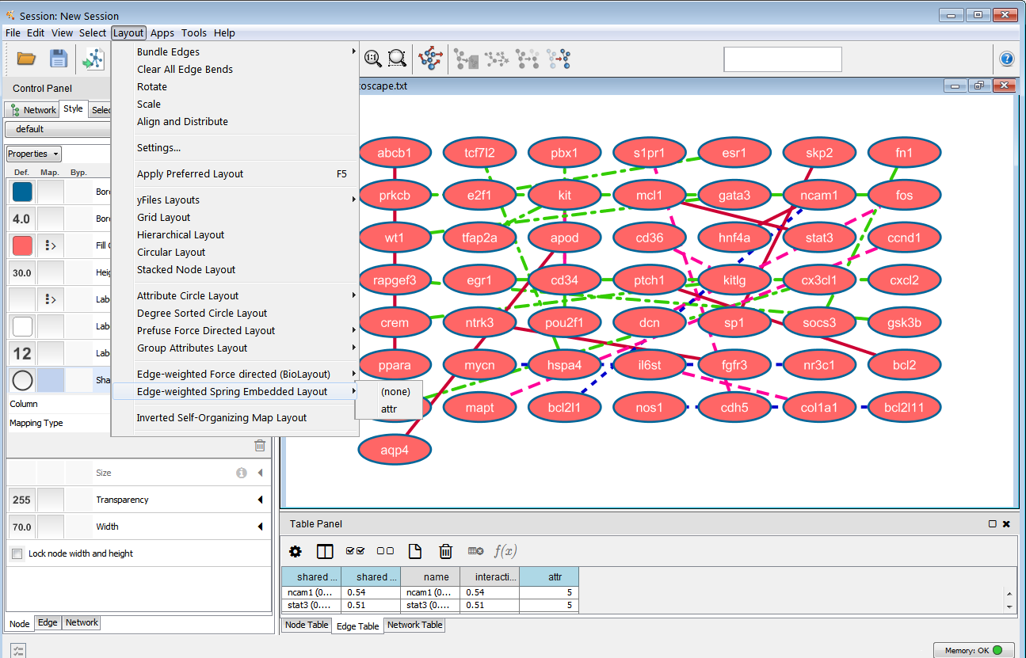
Network layout views

Slide 12
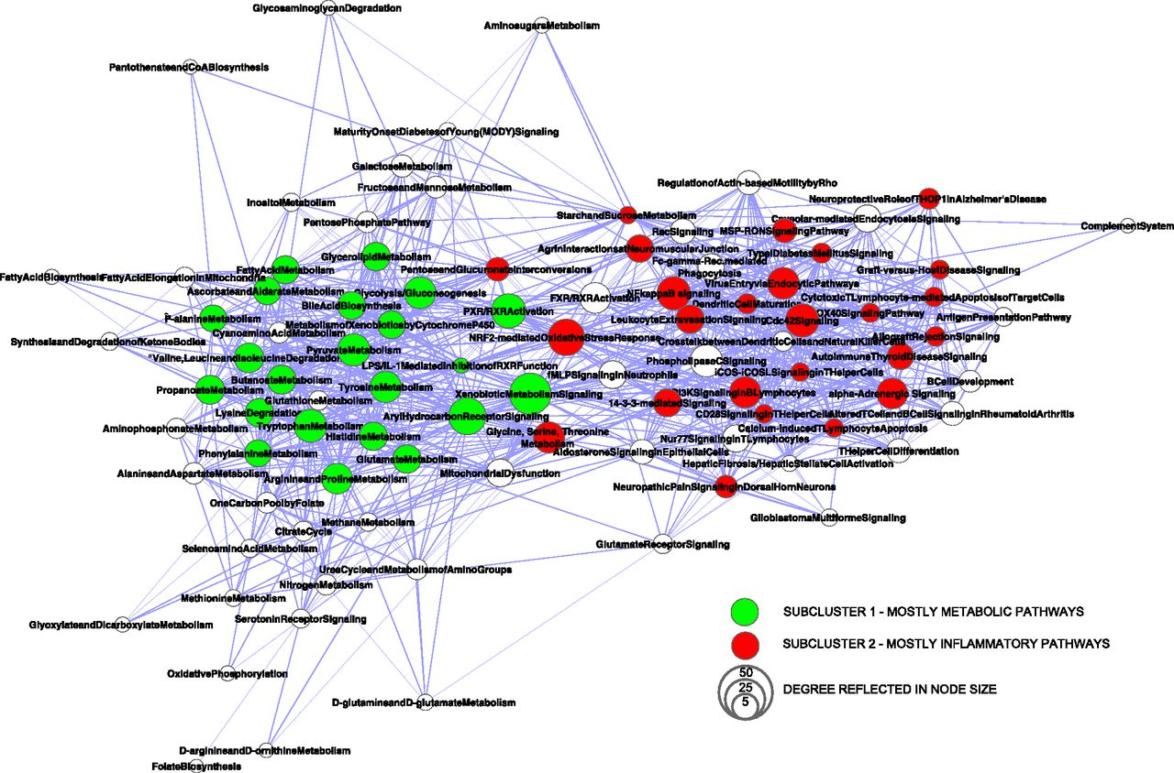

Integration of GFR-associated loci with transcriptional data allowed for the generation of a comprehensive pathway map of CKD. Network graph of 97 CKD-associated pathway nodes connected by transcripts coregulated with CKD candidate genes.
Sebastian Martini et al. JASN 2014;25:2559-2572
©2014 by American Society of Nephrology
Notes:
Integration of GFR-associated loci with transcriptional data allowed for the generation of a comprehensive pathway map of CKD. Network graph of 97 CKD-associated pathway nodes connected by transcripts coregulated with CKD candidate genes. Nodes display significantly (P<0.05) enriched pathways derived from two or more lists of coregulated candidate genes, and node size reflects the number of connections to other pathways (degree). A spring-embedded layout is applied, pulling together pathway nodes according to the number of shared genes among pathways. Unbiased cluster analysis of the CKD pathway network separates a subcluster of mainly inflammation-related pathways (red nodes; i.e., NRF2-mediated oxidative stress response, Cdc42 signaling, and NF-κB signaling) and a subcluster of several metabolic pathways (green nodes; i.e., fatty acid metabolism, glycolysis/gluconeogenesis, and tyrosine metabolism). Subclusters were identified by AllegroMCODE, a Cytoscape plug-in, on the original CKD pathway network.

Slide 13
Apps
To install an app: Apps -> App Manager-> Select app from the second column-> Click Install. ( Installation occurs automatically)
To update a app: Apps -> App Manager-> Check for updates
Each of these apps try to address different questions from your data
The key is get familiar with each app and know what a specific app can do for you in terms of your hypothesis/research question.
Reactome
Metscape
Additional apps
Bingo
Agilent Literature Search
MCODE

Slide 14
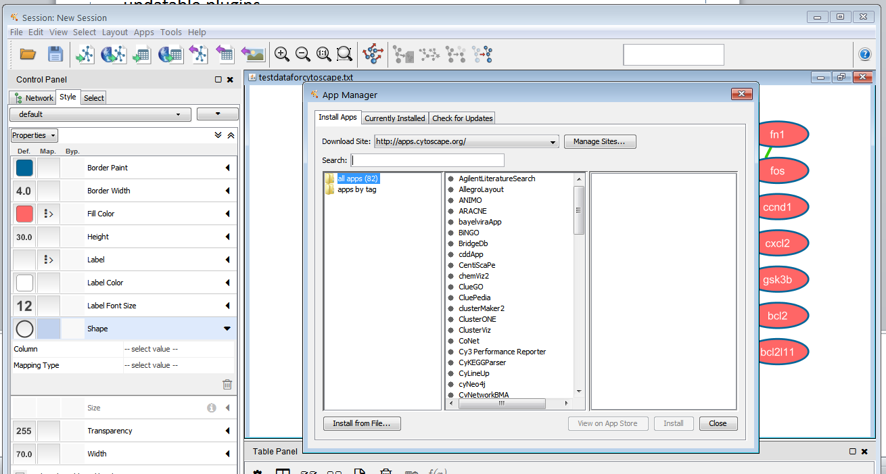
Enter the term here

Slide 15
Reactome FI plugin
Reactome app interrogates the Reactome pathway database
Query the Functional Interaction Network for the genes of interest
Fetch the FI annotations for evidence of interactions
Construct network modules of highly connected genes
Enrichment analysis of the modules
Notes:
This plugin accesses the Reactome Functional Interaction (FI) network, a highly reliable, manually curated pathway-based protein functional interaction network covering close to 50% of human proteins, and allows you to construct a FI sub-network based on a set of genes, query the FI data source for the underlying evidence for the interaction, build and analyze network modules of highly-interacting groups of genes, perform functional enrichment analysis to annotate the modules, expand the network by finding genes related to the experimental data set, display pathway diagrams, and overlay with a variety of information sources such as cancer gene index annotations

Slide 16
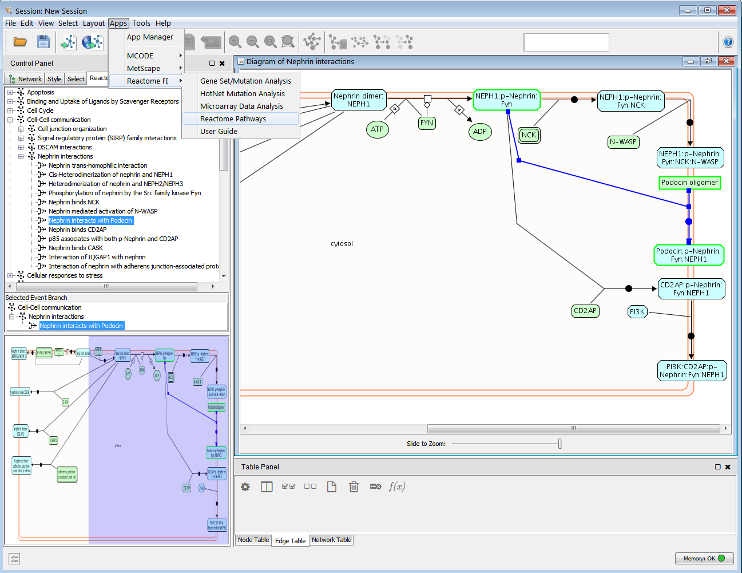
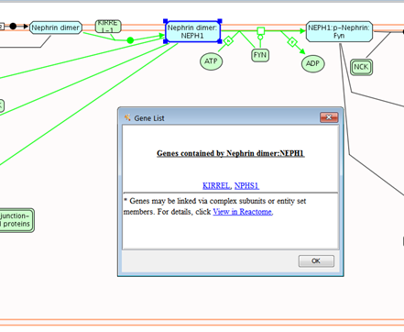
Reactome Pathways
Apps → Reactome FI → Reactome Pathways
Select the pathway/mechanism of interest
Right click and select “View in Diagram
Right click on the empty space in the network view panel
Options to export/search
Search Nephrin
Right click “Nephrin dimer” and select “List Genes”

Slide 17
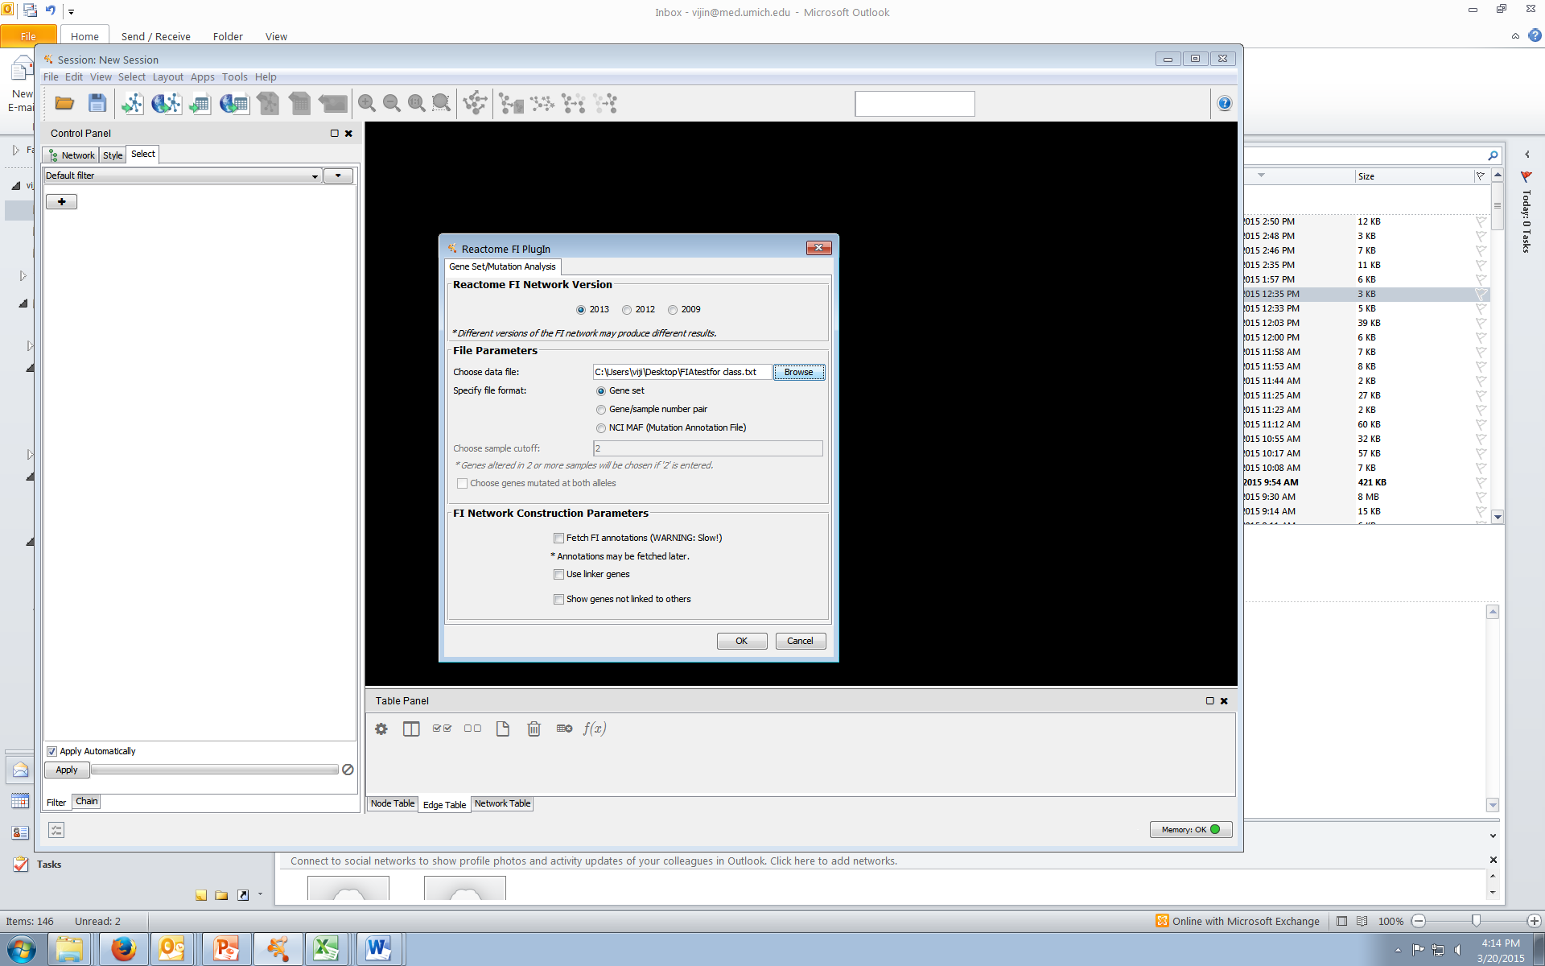
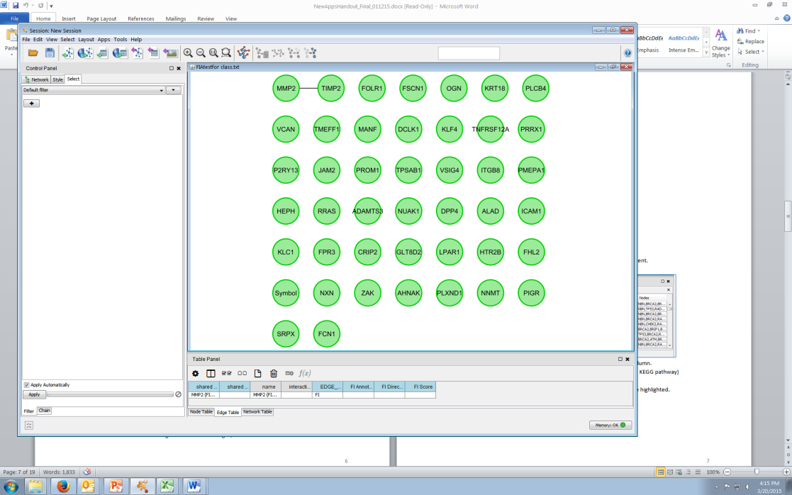
Creating Network using the app
Apps → Reactome FI → GeneSet Mutation Analysis
Select the most recent version
Upload your list of genes, one gene symbol per line

Slide 18
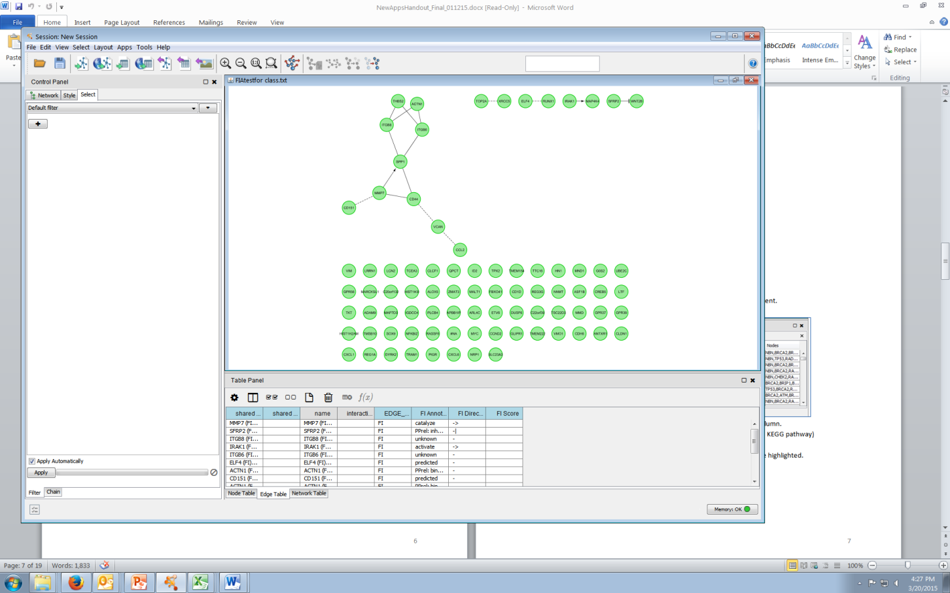
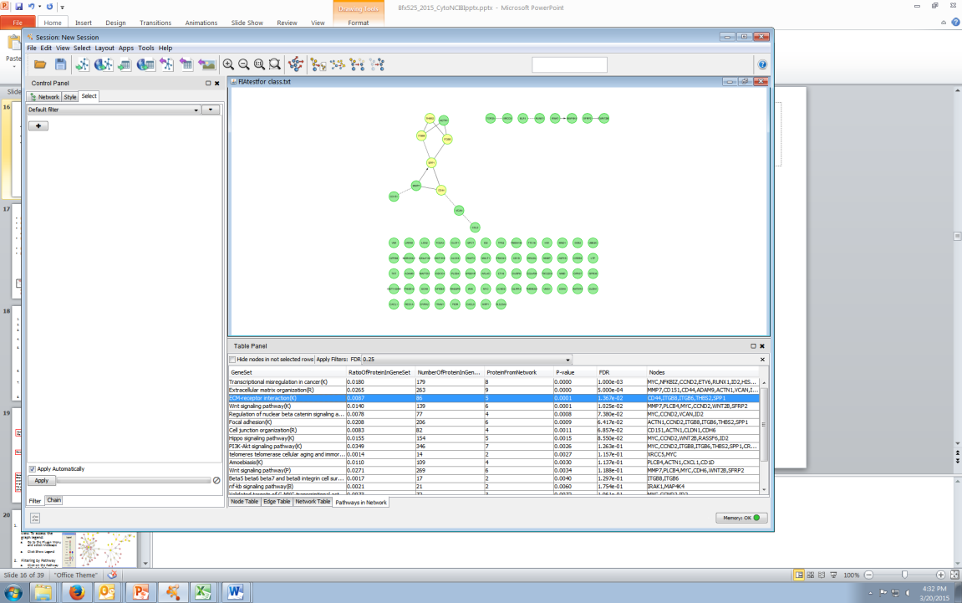
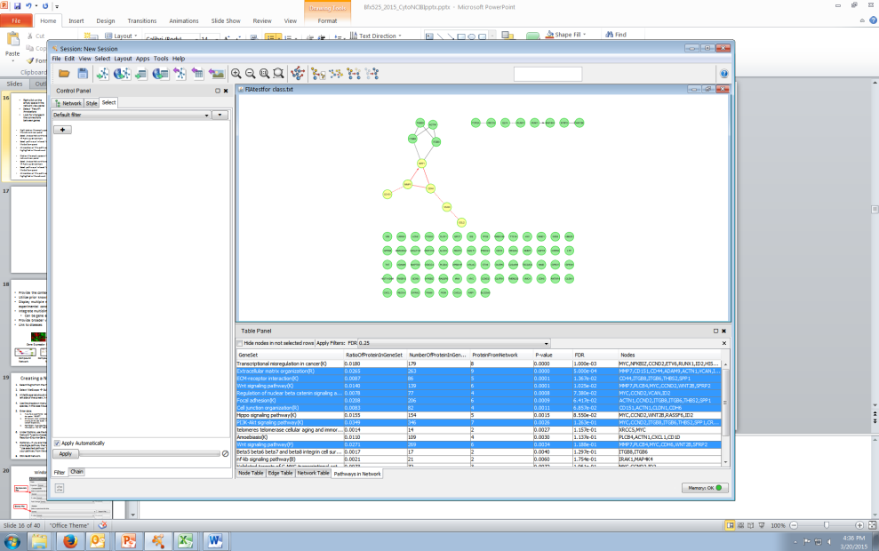
Right click on the empty space in the network view panel
Select “Fetch FI Annotations
Look for changes in the connections between genes
"->" activating/catalyzing
"-|" for inhibition
"-" FIs extracted from complexes or inputs
"---" predicted FIs
Right click on the empty space in the network view panel
Select Analyze Network Functions → Pathway Enrichment
Select pathway of interest from the bottom panel
All members of this pathway are highlighted in the network
Click on the empty space in the network view panel
Select Genes of interest
All pathways interacting with these genes are highlighted in the bottom panel.
Notes:
Fetch FI annotations: query detailed information on selected FIs. Three FI related edge attribues will be created: FI Annotation, FI Direction, and FI Score. Edges will be displayed based on FI direction attribute values. In the following screenshot, "->" for activating/catalyzing, "-|" for inhibition, "-" for FIs extracted from complexes or inputs, and "---" for predicted FIs. See the "VizMapper" tab, Edge Source Arrow Shape and Edge Target Arrow Shape values for details.

Slide 19
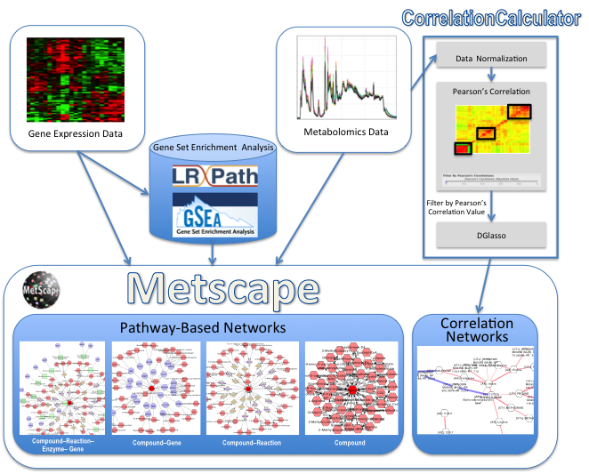
Metscape
Provide the context for experimental data
Utilize prior knowledge of metabolic networks
Display multiple measurements across observations, time points, experimental conditions, etc.
Integrate multidimensional data
Can be gene expression and metabolomics data
Provide broader view of metabolic networks
Link to diseases
SPGRAM
Notes:
Metscape was developed by Alla Karnovsky .EHMN - Edinburgh Human Metabolic Network
The image shows workflows involved in MetScape. You can use gene expression data, Metabolomics data, and/or gene set enrichment analysis (not all are necessary). You can then build the network types shown here.

Slide 20
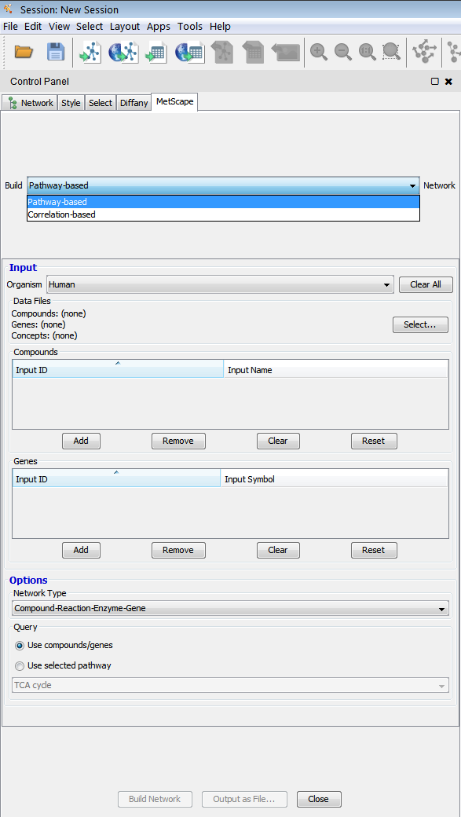
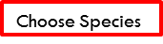
Creating a Network Using the MetScape App
Select Apps from the menu bar.
Select MetScape → Build Network.
Choose either Pathway-Based or Correlation-Based.
A MetScape tab should now appear on the left side of the screen, in the Control Panel.
Pathway based :
Use the dropdown menu to choose a species,
Enter data:
If you have experimental data, browse your file using the option “SELECT.”
OR manually enter compound/gene names by clicking on the Add button in the Compounds/Gene section respectively .
Under Options, use the dropdown menu for Network Type to choose Compound-Reaction-Enzyme-Gene.
Optional – If you are interested in studying one single pathway then select the option “Use selected pathway” and then choose your pathway from the dropdown menu.
Click Build Network.
Species
Input
Choose Network Type

Slide 21
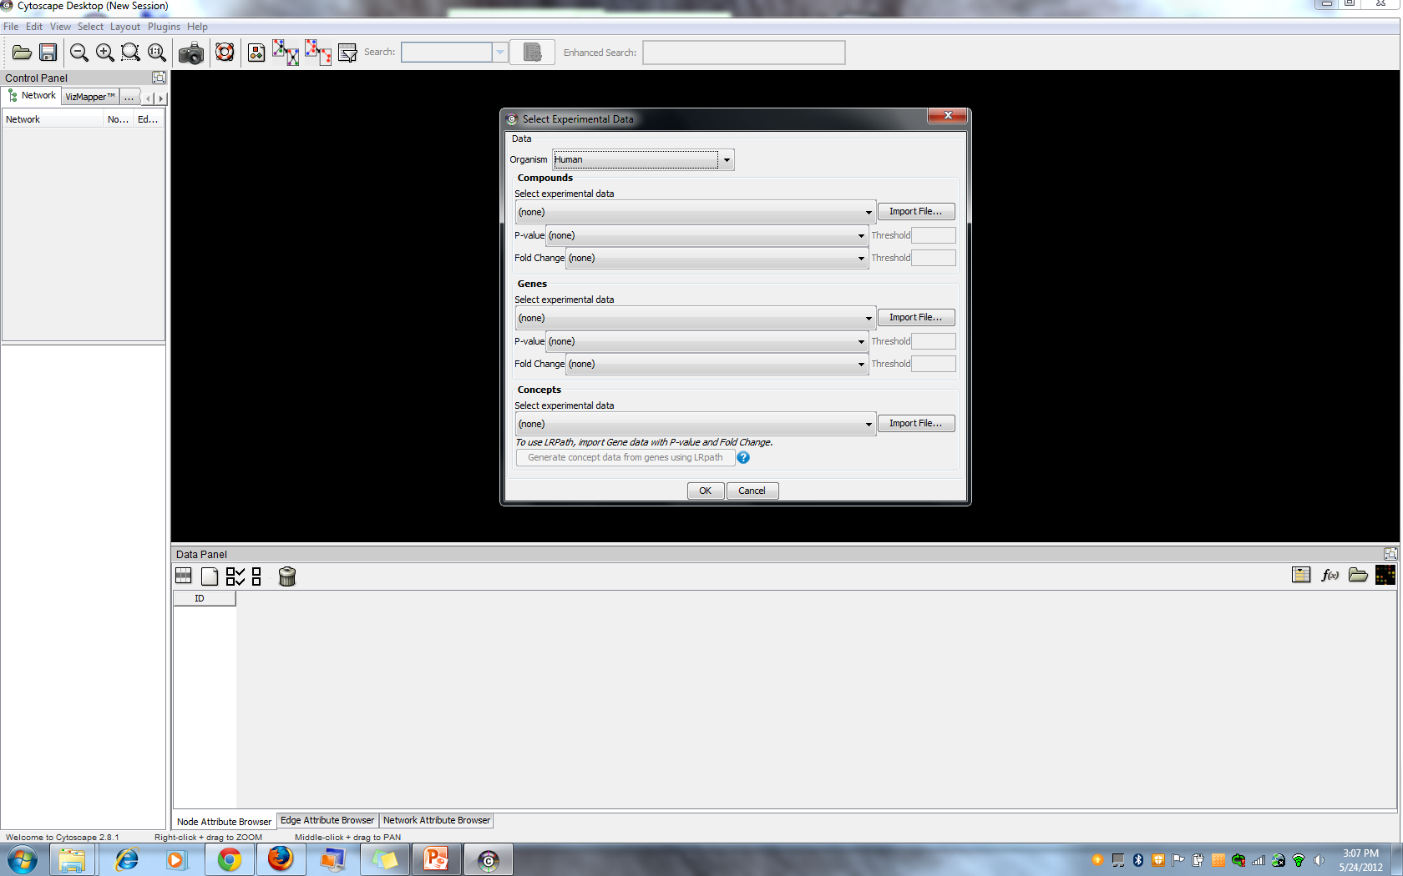
Window for Loading Experimental Data
Compounds File
metscape_test.csv
Genes File
Concepts File: Either import existing file or generate a file using LRPath
Notes:
This is the window for loading experimental data. You can load a compounds file, a genes file, and/or a concepts file. If you do not already have a Concepts file, you can generate one using the Lrpath button.

Slide 22
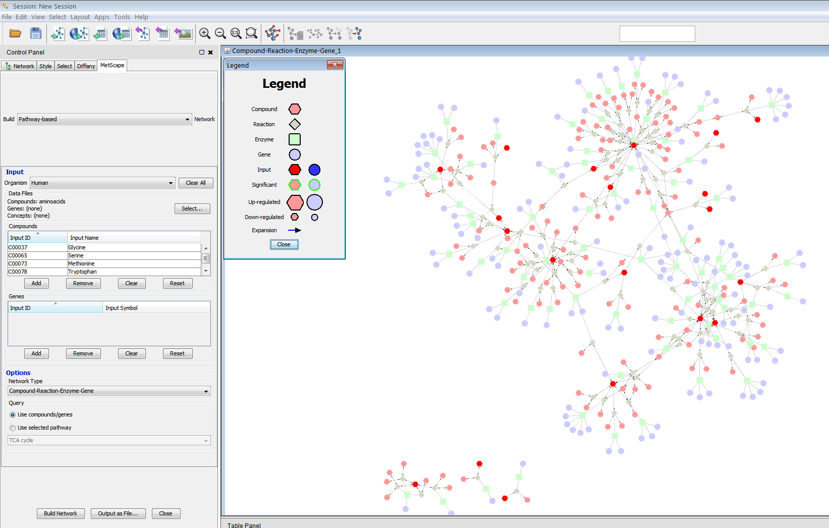
Metscape Pathway based Network
A network graph now appears in the main view. To access the graph legend:
Go to the Plugin Menu and select MetScape
Click Show Legend

Slide 23
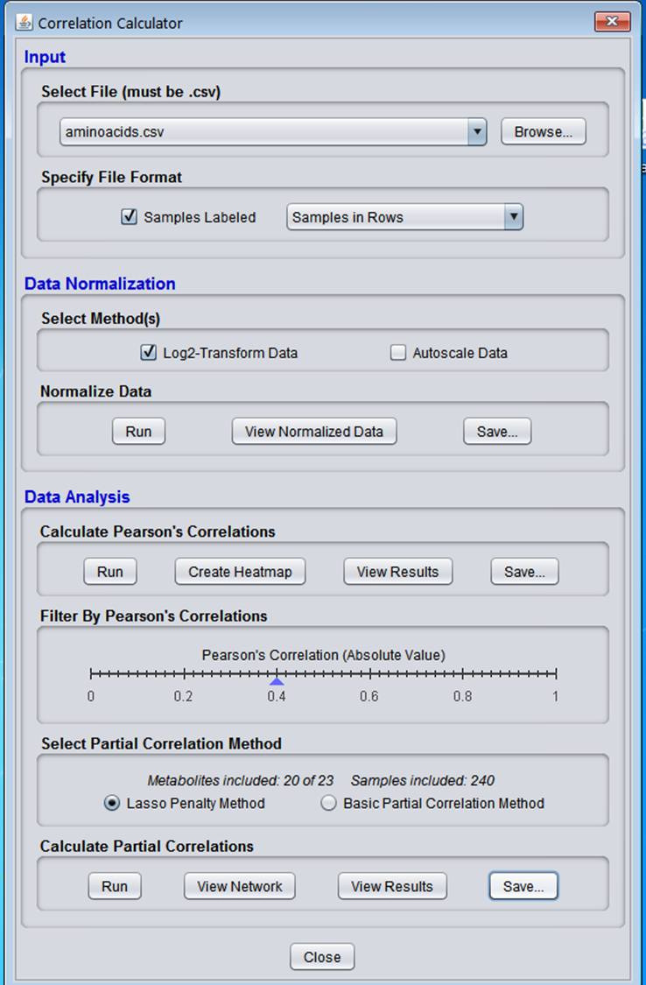
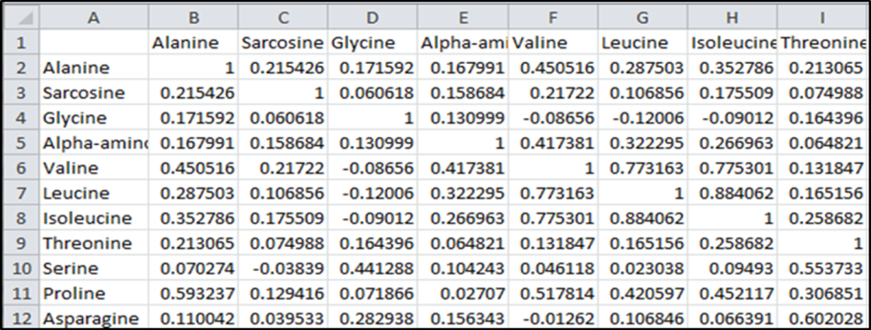
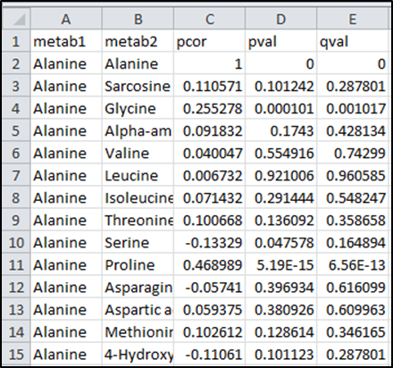
Correlation Based Network Using the MetScape App
Download the Correlation Calculator (http://metscape.ncibi.org/calculator.html)
Correlation File: Matrix-Based
Correlation File: Column-Based

Slide 24
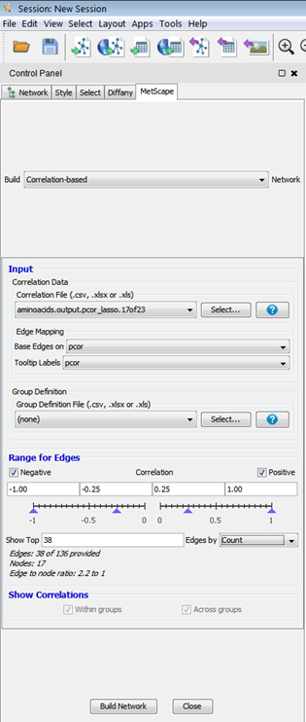
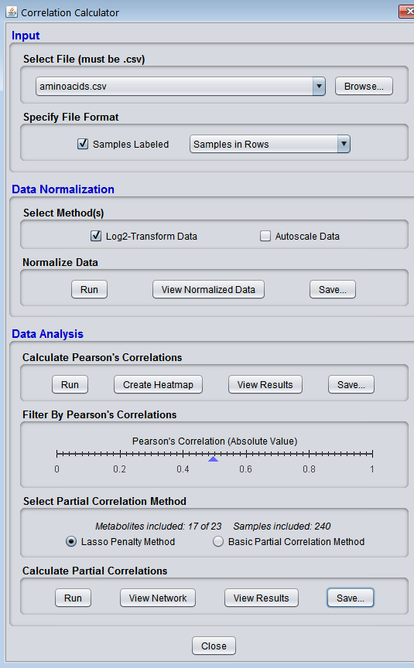
Correlation Based Network Using the MetScape App
Download the Correlation Calculator (http://metscape.ncibi.org/calculator.html)

Slide 25
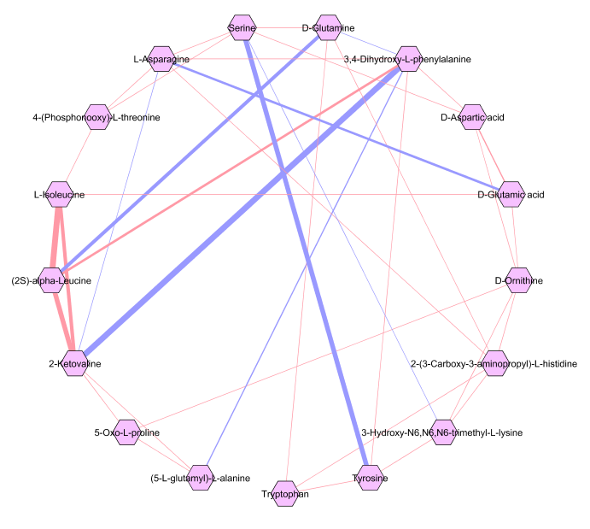
Visualization:
Blue edge: -ve correlation
Red Edge : +ve correlation
The thicker the edge, the stronger the correlation.
Purple nodes represent mapped compounds.
White nodes represent compounds that did not map to a known compound in the MetScape database.

Slide 26
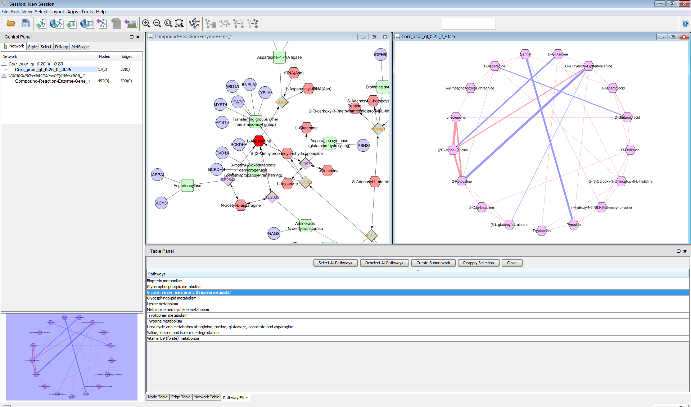
Metscape Network
Control panel →Network tab
Select :
Select the pathway based network
Select the correlation based

Slide 27
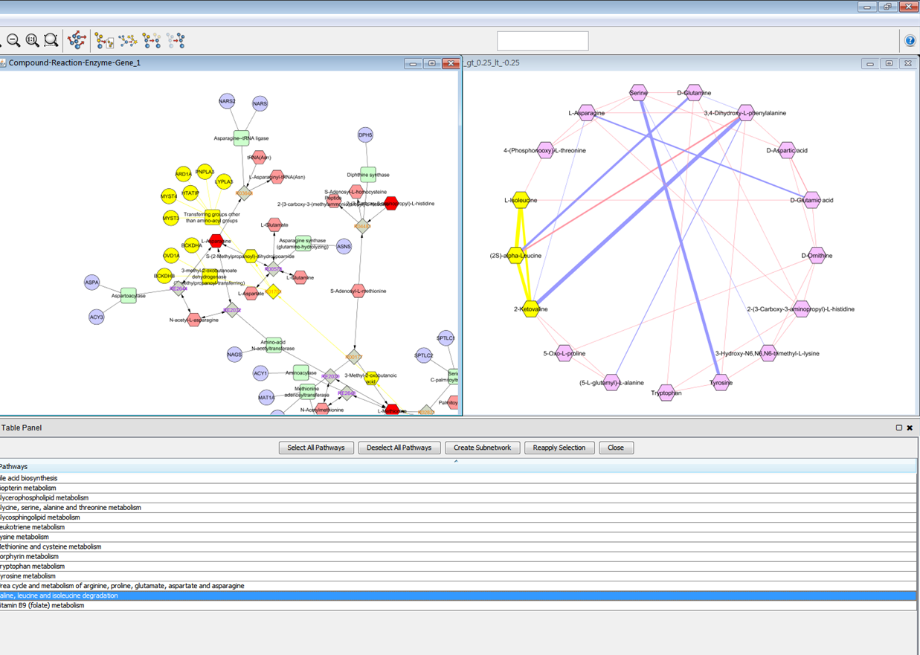
Metscape Network
Filtering by Pathway
Select one of the networks
Click on the Pathway Filter tab if it is not already open in the Attribute Browser panel.
Select “Valine, leucine and isoleucine degradation“
This pathway should now be highlighted in the network.
Select the other network and repeat the same steps.

Slide 28
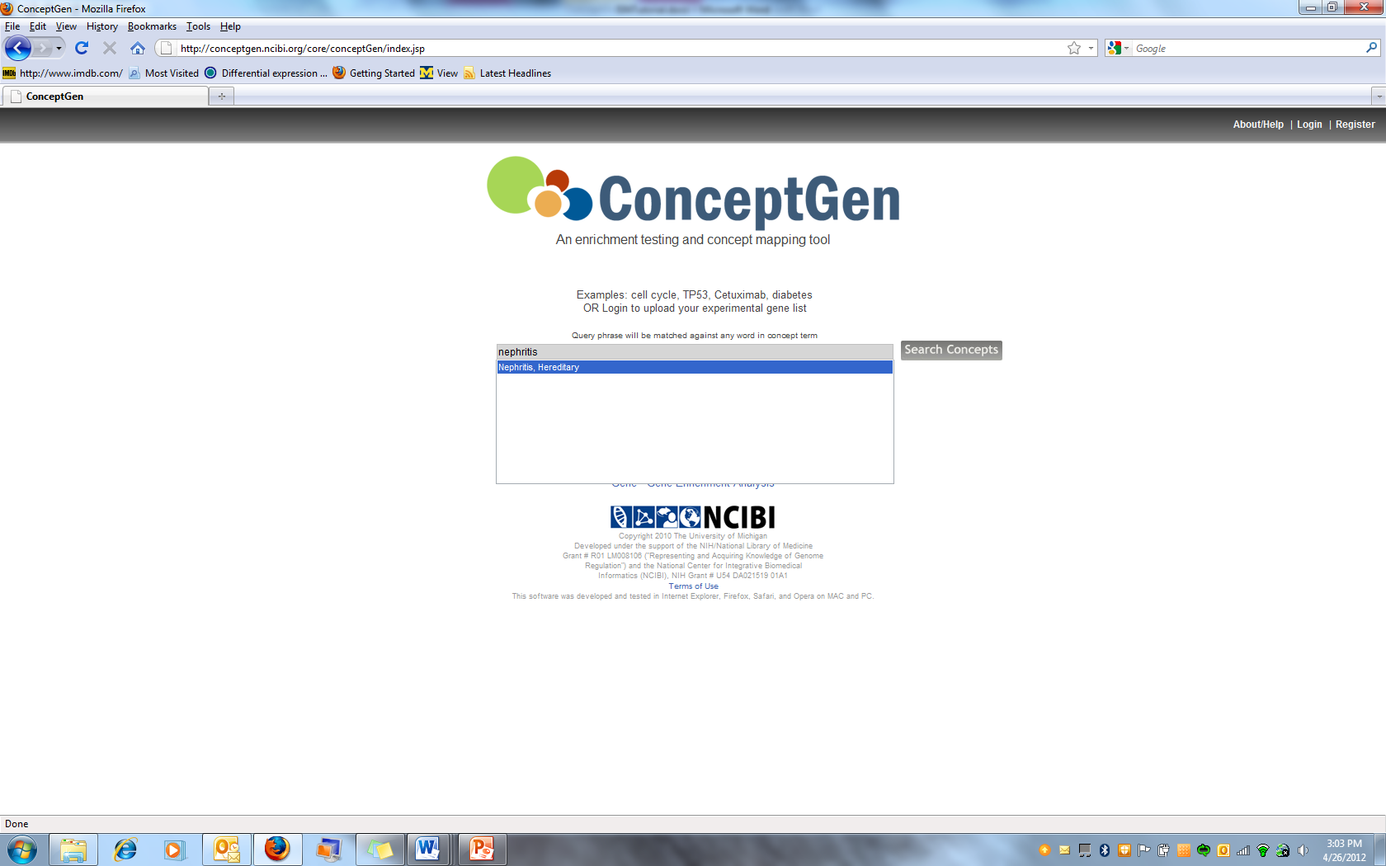
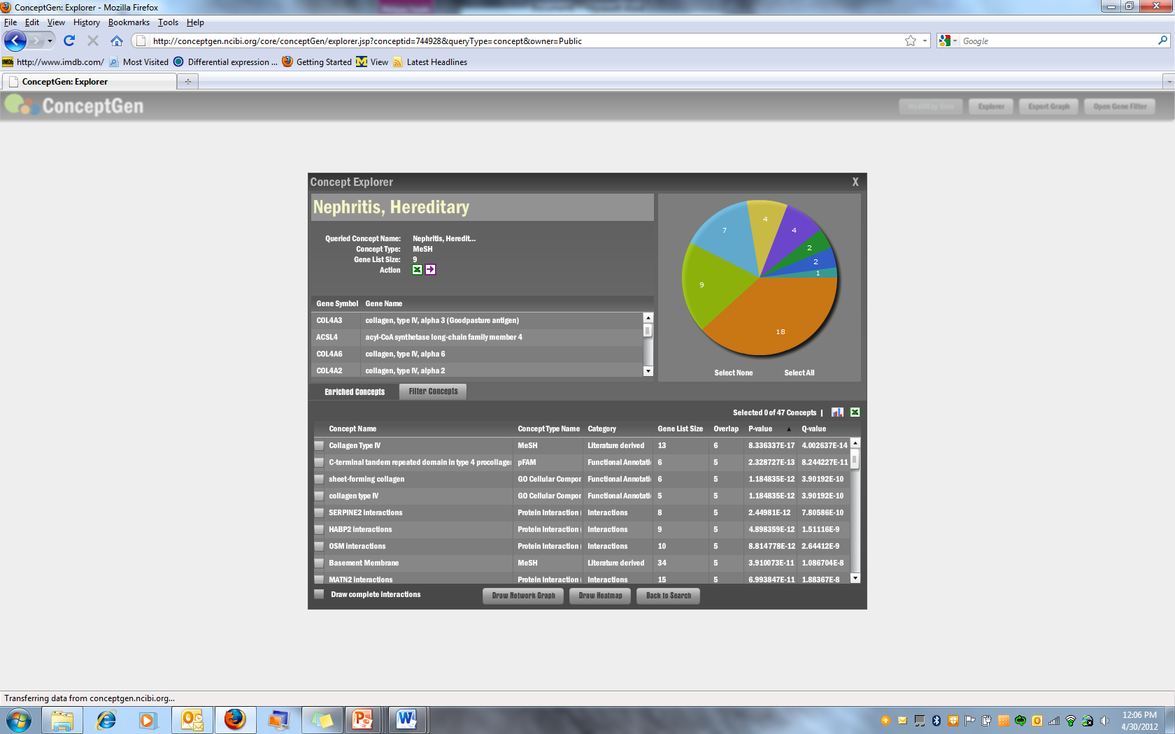
A gene set enrichment and concept mapping tool
Use to help identify relationships and significant overlaps among sets of genes (concepts)
To create own concept, load only significant genes
Notes:
After first bullet say – in bioinformatics tools the term concept often refers to a list of genes. The list of genes might be a set of enriched genes - through statistical analysis - that are annotated with some ontology or other standardized vocabulary term - like Collogen Type IV in this screen shot. You can also make your own concept with gene lists that represent important values from your experiment - like differential expression.
By enrichment, we mean that the overlap between two lists of genes is greater than expected by chance
Can load a list of genes to create own concept or use the search box to search for a predetermined concept

Slide 29
Query to Find Concepts Similar to a Concept of Interest
Go to the ConceptGen homepage (http://conceptgen.ncibi.org/).
In the search box, enter Nephritis.
Click on the Search Concepts button.
This takes you to the Search Results page. For each result, you will get a summary showing the Concept Type, number of genes in the list, and number of enriched concepts.
Click on the last result: Nephritis, Hereditary.
Notes:
Go to the homepage and enter a term in the searchbox. A list of semantically similar terms will be provided and choose the one most appropriate. This then takes you to a Search Results page where you choose the best result. This then takes you to the Concept Explorer window for that result (see next slide)

Slide 30
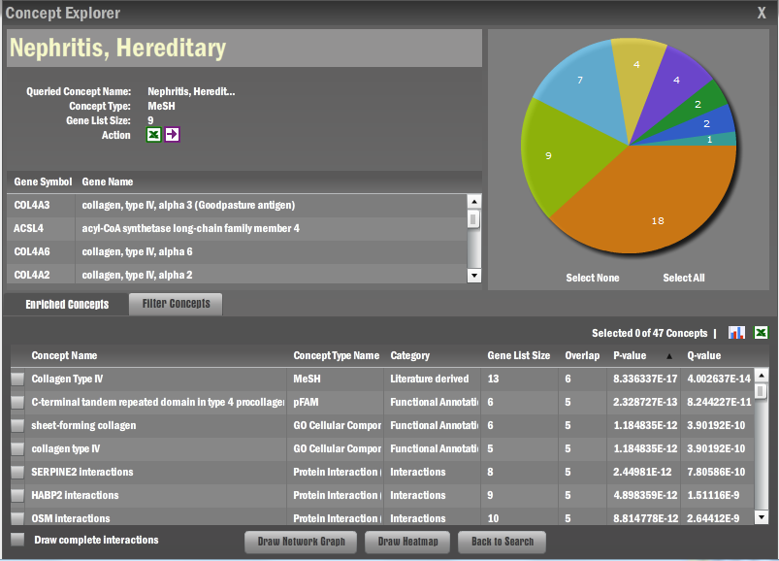
Overview of the Concept Explorer
Look at the genes associated with Nephritis, Hereditary by scrolling through the gene list provided.
Mouse over the slices of the pie chart to see the concept types associated with the enriched concepts (ex. Protein Interaction (MiMI), MeSH, etc).
Scroll through the enriched concepts in the lower half of the window.
These concepts have a larger number of overlapping genes with Nephritis, Hereditary than is expected by chance.
To sort the concepts alphabetically by name, click on the Concept Name column heading.
Pie chart representing sources
Notes:
After you cover info on this slide: you can then draw networks of selected enriched concepts, get more details about the concepts, and draw networks for the genes that make up a given concept.

Slide 31
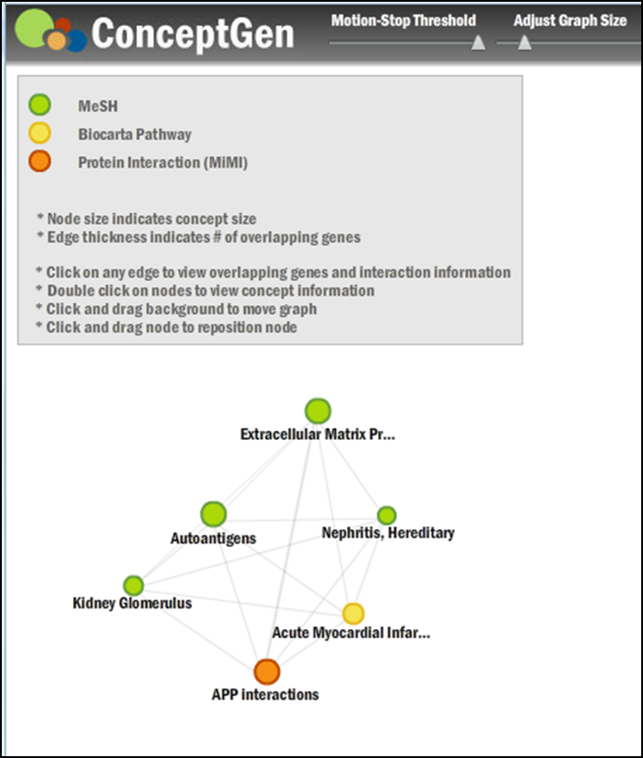
Exploring Concepts Using a Network Graph
Check the boxes next to the following concepts of interest:
APP Interactions, Acute Myocardial Infarction, Autoantigens, Extracellular Matrix Proteins, Kidney Glomerulus
Check the box next to Draw complete Interactions.
Click on the Draw Network Graph button.
A graph of the network, with nodes and edges, should now be visible.
Each node represents a different concept
Each edge represents a connection between concepts
Node size indicates the size of the concept
Edge thickness indicates the number of overlapping genes between the two connecting concepts
Node color represents the concept type
Double click on the node “Nephritis, Hereditary”.
A popup window appears providing details on this concept.
Click on the edge between “Nephritis, Hereditary” and “APP Interactions”
A popup window appears showing the genes that overlap between these two concepts.
Notes:
Several of the enriched concepts in the list seem interesting. Therefore, you want to further explore these concepts and their relationship to your query concept and each other.
Click the X at the top right of the popup windows to close it.
Draw Complete Interactions-view links between all selected concepts and not just links between your gene list and and the enriched concepts.

Slide 32
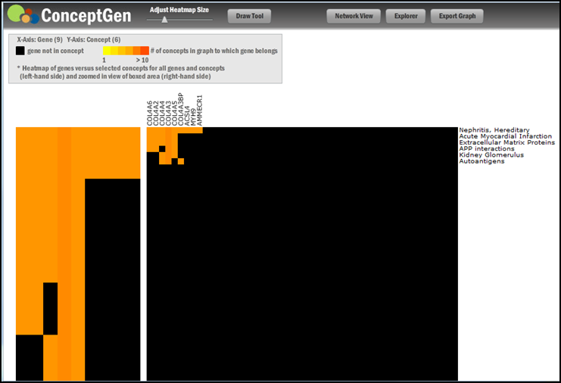
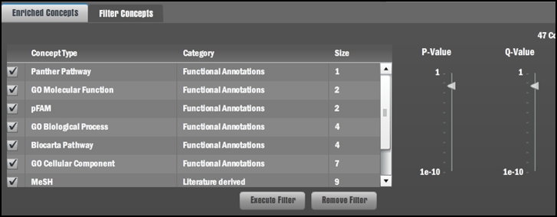
Visualizing Information as a Heatmap
1. Return to the Concept Explorer window by clicking on
the Explorer button at the top right of the concept
network graph window.
2. The previously selected concepts should still be selected
in the Concept Explorer window.
3. At the bottom of the Concept Explorer window, click on
Draw Heatmap.
5. A heatmap is drawn based on the selected concepts.
Filtering Concepts
You may change the filter preferences, thereby filtering the list of enriched concepts for your gene set.
1. Return to the Concept Explorer window
2. Click on the Filter Concepts tab, located above the list of
concept names.
3. Uncheck boxes next to the concept types that you do not
want included AND/OR click and drag up or down the
arrows under P-Value and Q-Value.
4. Click the Execute Filter button at the bottom of the
window.
5. A new pie graph is drawn, representing the remaining
concept types after executing the filter

Slide 33

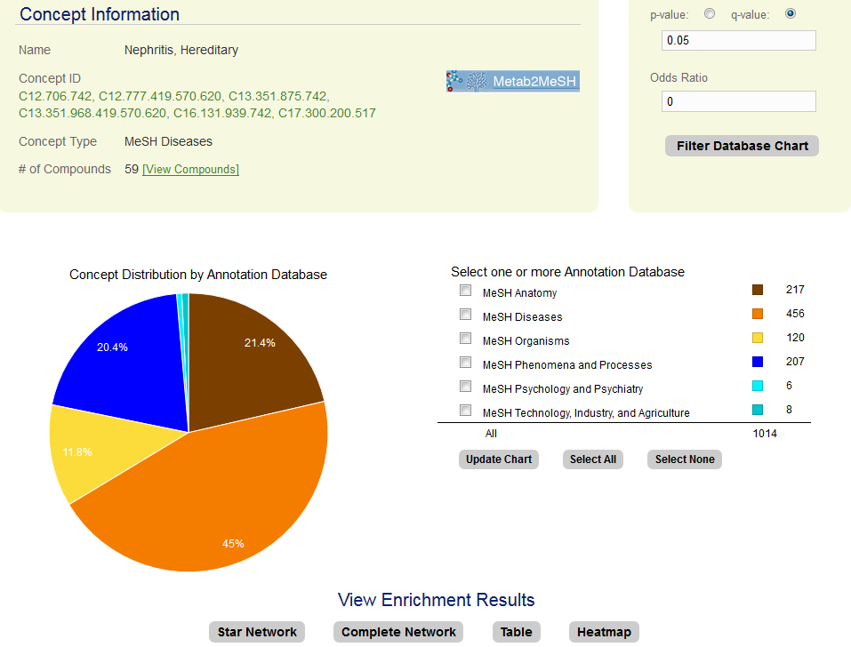
http://conceptmetab.med.umich.edu/
Mapping and exploring relationships among metabolite sets (concepts)

Slide 34
Publications
Smoot M, et al. Cytoscape 2.8: new features for data integration and network visualization. Bioinformatics. 2011; 27(3): 431-2. PMID: 21149340
Karnovsky A, et al. Metscape 2 Bioinformatics Tool for the Analysis and Visualization of Metabolomics and Gene Expression Data. Bioinformatics 2012; 28(3): 373-80. PMID: 22135418
Sartor MA, et al. ConceptGen: a gene set enrichment and gene set relation mapping tool. Bioinformatics 2010; 26(4): 456-63. PMID: 20007254
Kim JH, et al. Lrpath analysis reveals common pathways dysregulated via DNA methylation across cancer types. BMC Genomics 2012; 13: 526. PMID: 23033966
Cavalcante RG, et al. ConceptMetab: exploring relationships among metabolite sets to identify links among biomedical concepts. Bioinformatics 2016; [epub ahead of print]. PMID: 26794319
Wu G., et al. 2014. ReactomeFIViz: a Cytoscape app for pathway and network-based data analysis. F1000Research 3:146.
Notes:
I’m missing the LRpath publication info

Slide 35
Useful links
Cytoscape User Manual: http://wiki.cytoscape.org/Cytoscape_3/UserManual
ConceptGen User Guide: http://portal.ncibi.org/gateway/pdf/ConceptGen%20User%20Guide.pdf
ConceptGen Video Tutorial: http://www.screencast.com/t/7UXSz3pPix
MetScape User Guide: http://metscape.ncibi.org/MetScape3.1_User_Manual.pdf
MetScape Pathway Network Video Tutorial: http://sibko.med.umich.edu/av/mst2.html
MetScape Correlation Network Video Tutorial: https://www.youtube.com/watch?v=C9zWsyW9hSI&feature=youtu.be
LRpath Video Tutorial: http://sibko.med.umich.edu/av/lrp.html
ConceptMetab User Manual: http://conceptmetab.med.umich.edu/pdf/ConceptMetab_Tutorial.pdf

